Slide 1
Law Enforcement Management System(LEMS)
Group B
Software Engineering Project

Slide 2
Significance of LEMS
Increased Efficiency: Makes work smoother, less paperwork, and uses resources better.
Enhanced Collaboration: Makes it easier for different groups to talk and plan together.
Data-Driven Insights: Uses information to make smart choices. Looks at data to help decide what to do next.
Compliance and Transparency: Makes sure everyone sticks to the rules and is open about what they do.

Slide 3




How the System works?
Citizen
SHO
File a Complain
View the Complains Status
SHO reviews the complaint details and begins the investigation.
Assigns the Officers to Investigations including the leading Officer for the Investigations
SHO also assigns Patrolling to officers.
Either is a dispatch Patrol for reviewing the complain status or just regular Patrolling.
HR
Hires the officers
Username and Passwords are allocated
Salary according to the rank is allocated
Also in Charge of Promotion and Demotion
Administrative
Staff
Administrative staff allocate vehicles and weapons to officers when assigned an investigation
Also allocates vehicles for Patrolling

Slide 4




How the System works?
Investigation
Investigating officer gathers evidence and apprehends suspects.
Updates the complaint status to “Solved" upon successful resolution.
Correctional Process
Criminal in Jail
Correctional officers use the system to manage jail cells and assign criminals to appropriate facilities.
Assigned criminals are recorded within the system, along with their respective jail cell IDs.
Criminal Apprehension
Upon apprehending suspects, officers update the system with their details as criminals.

Slide 5

Whoa!
Principles
Rigor and formality
Anticipation of change
Separation of concerns
Abstraction
Incrementality
Whoa!

Slide 6
01
02
03
MODEL SELECTION : WATERFALL
04
05
06
Stable Requirements
Sequential Progression
Documentation Compliance
Risk Management
Clear Milestones
Limited Client Involvement

Slide 7
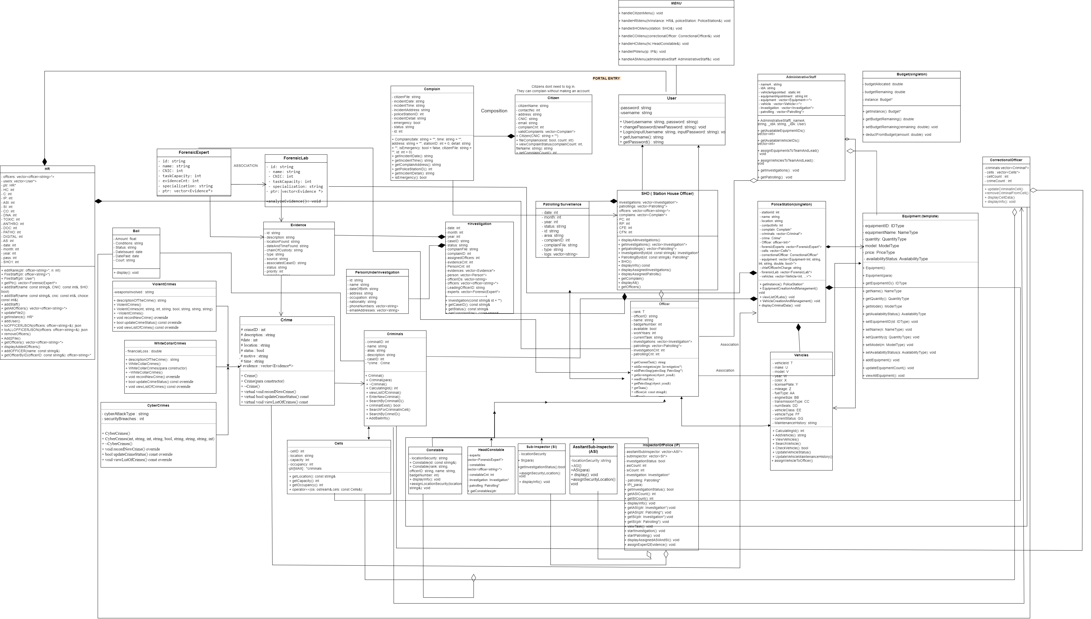
UML

Slide 8
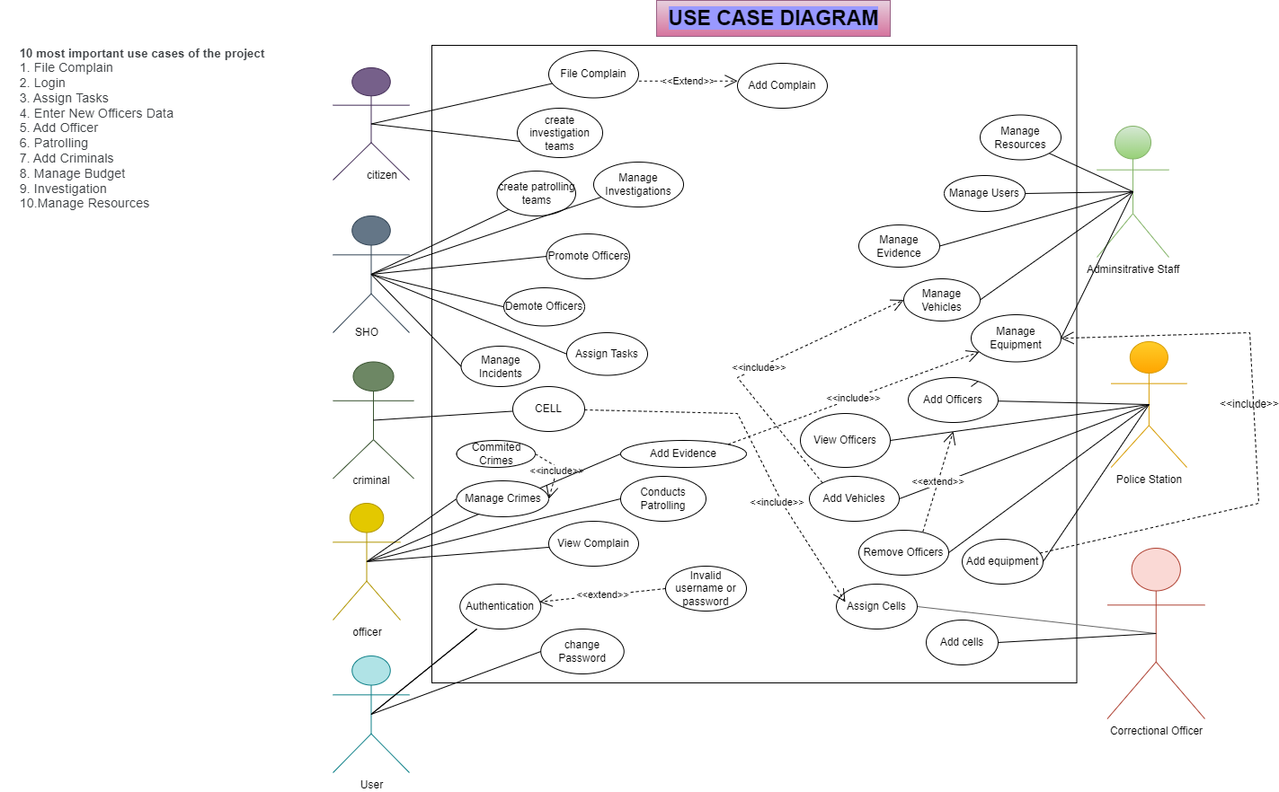
USE CASE DIAGRAM

Slide 9

Architecture :Client-Server Architecture
Servers
Database Server: Stores all officer, vehicle, complaint, investigation, and criminal records.
Application: Server: Hosts core application logic. Processes Requests from Clients
File Server: Stores and serves multimedia data efficiently. (Videos, Audios, Pictures)

Slide 10
Clients Officers using mobile devices, computers, or terminals can act as clients. Through a public-facing interface, citizens can act as clients within the law enforcement management system.
Officers
Citizens
AdministrativeStaff
Request vehicles/equipment.
Report incidents.
Access investigation data.
File complaints/incidents.
Track status.
Provide feedback.
Allocate resources.
Manage budgets/inventory.

Slide 11
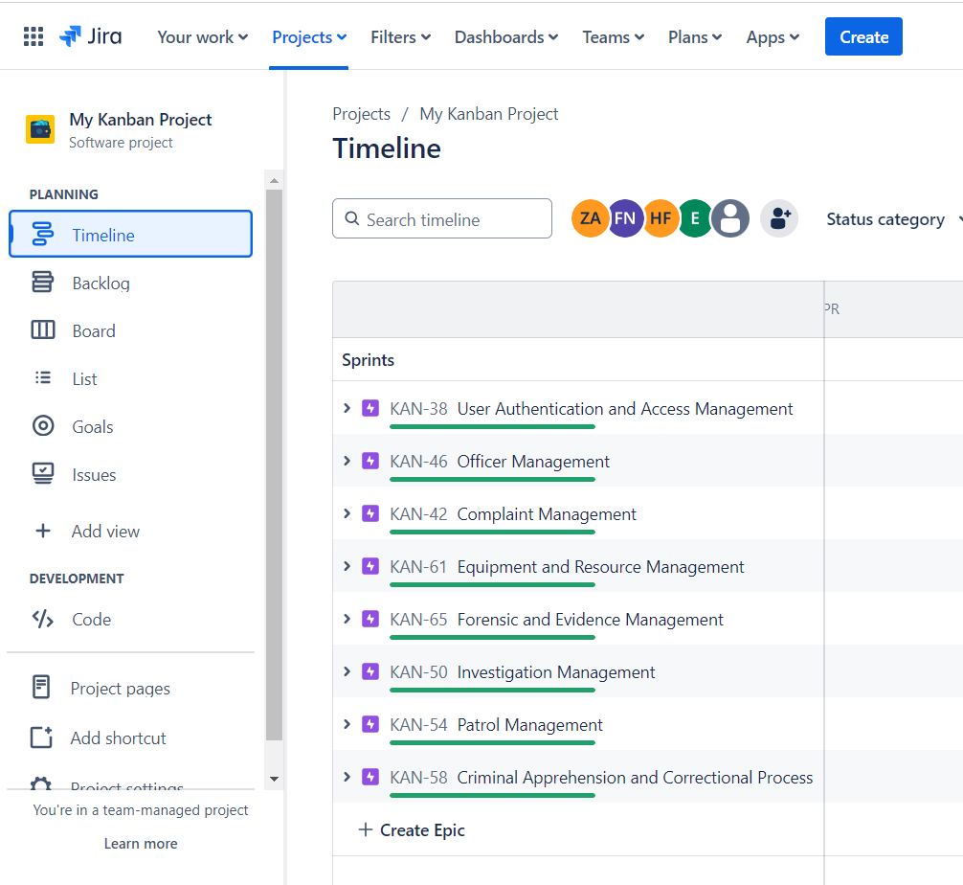
JIRA
Creation of EPICS
8 Epics for LEMS
User Authentication and Access Management
Complaint Management
Officer Management
Investigation Management
Patrol Management
Criminal Apprehension and Correctional Process
Equipment and Resource Management
Forensic and Evidence Management
Venus
Venus has a beautiful name and is the second planet from the Sun. It’s hot and has a very poisonous atmosphere

Slide 12
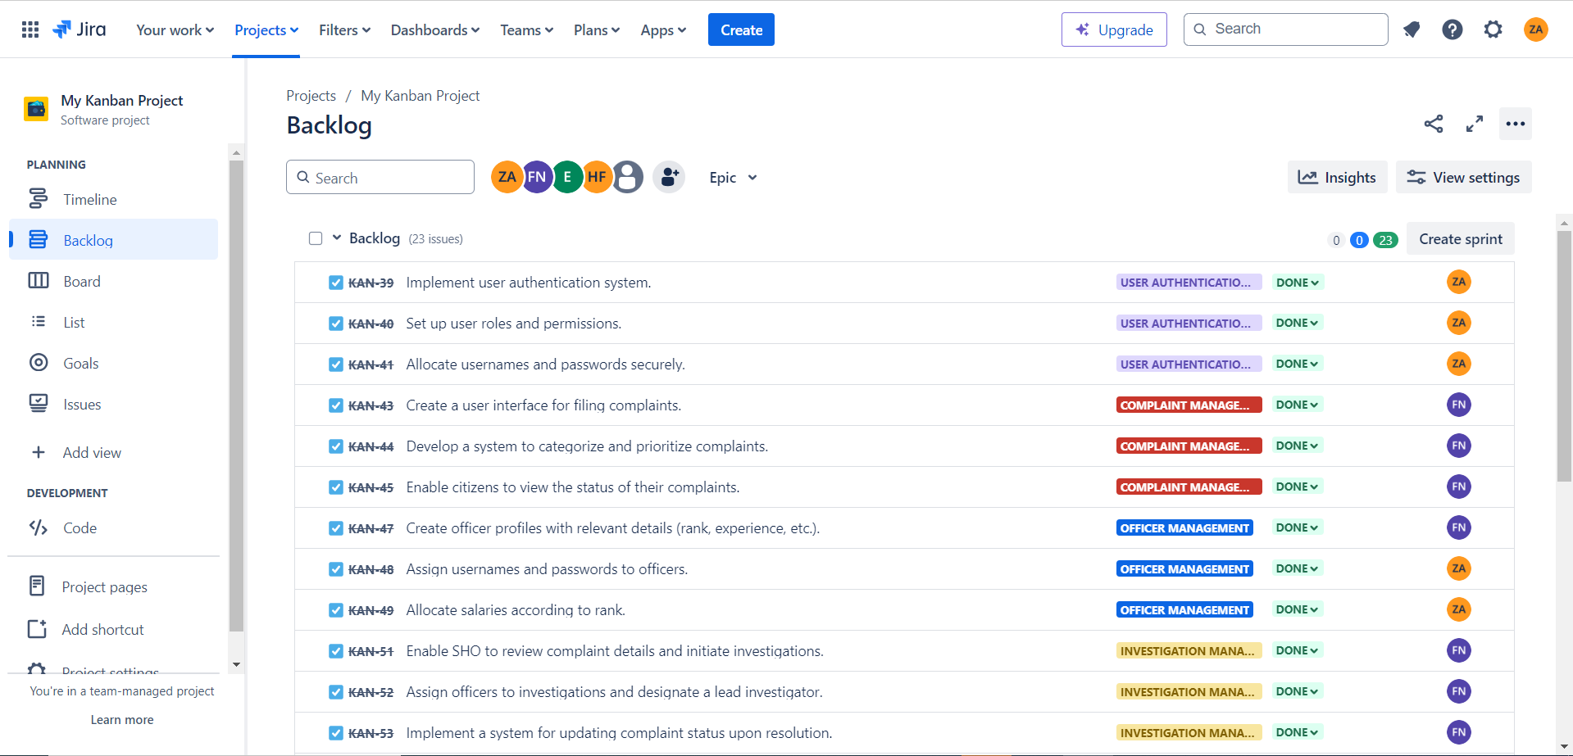
Issues for each Epic

Slide 13

THANK YOU
GROUP B !!!

